Slide 1
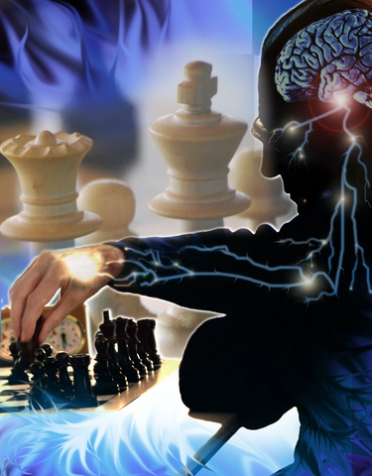
The Nervous System
Controls and coordinates all of the body’s activities

Slide 2
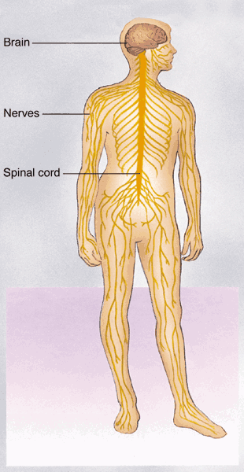
The Nervous System
Structure: Brain, spinal cord, peripheral nerves
Function: Sends and receives messages to the body in response to internal and external stimuli.
Nerves - A tissue containing cells that act as the basic unit of communication in the nervous system.
Notes:
2

Slide 3
CNS – processes all incoming and outgoing messages with the brain and spinal cord.
PNS – is the communication pathway from the CNS to the rest of the body.

Slide 4
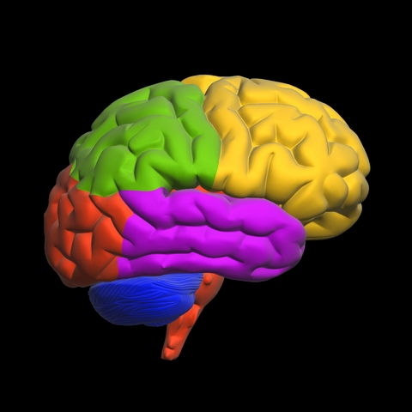
Central Nervous System - CNS
The primary organ of the nervous system. It acts as the control center for all actions, thoughts and emotions.
The brain contains approximately 100 billion neurons (nerve cells).
The slowest speed information travels between neurons is about 260 mph.
Brain
A bundle of nerves located down the center of the backbone through which signals travel from the brain to the rest of the body.
Some reflexes are processed directly in the spinal cord (like sneezing and blinking).
Reflex – a quick, automatic response to a stimulus. A reflex allows your body to immediately respond to danger without thinking.
Spinal Cord

Slide 5
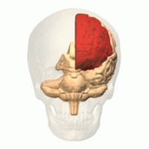
Brain
Frontal Lobe
Parietal Lobe
Occipital Lobe
Temporal Lobe
Cerebrum
Brain Stem –
Medulla
Cerebellum
Cerebrum – largest part of brain. Voluntary or conscious movement and activities. Deep grove creates a right and left hemisphere. Right half is creativity and artistic abilities. Left is analytical and mathematical ability.
Cerebellum – second largest part. Helps muscles be more efficient , graceful and keeps balance.
The Brain Stem – connects brain and spinal cord. Controls heart rate, breathing and blood pressure (Medulla).

Slide 6
The Autonomic Nervous System regulates activities that are automatic, or involuntary. Organs such as heart, stomach and intestines are regulated by the ANS. The ANS is what tells our body to breathe and digest food.

Slide 7
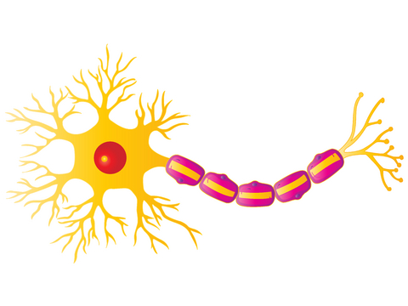
Neuron Nerve cell that transfers messages throughout the body using electrical signals.
Dendrites –
branch of neuron that receives impulses
Cell Body
Axon – fiber that transmits messages from cell to cell
Nucleus

Slide 8
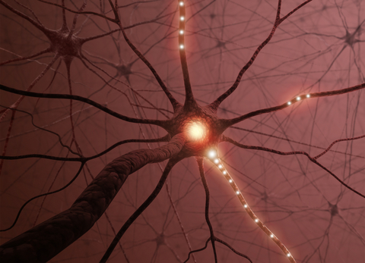
CNS – brain and spinal cord
PNS – all the nerves going throughout the body

Slide 9
Endocrine System
Main role is to respond to stimuli (internal and external) by sending chemical messages to the body.

Slide 10
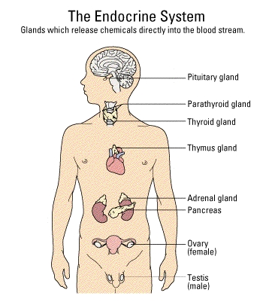
Gland – a group of cells that make special chemicals for the body.
These chemicals are called hormones.
Testes(males)

Slide 11
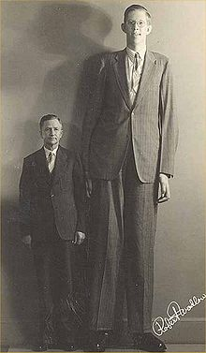
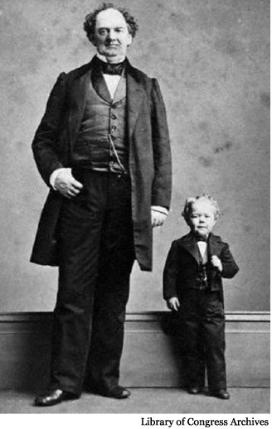
Pituitary – growth
hormone
Testes(males)

Slide 12
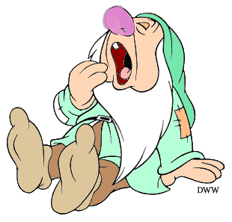
Thyroid – increases the rate at which you burn energy.
Parathyroid – regulates level of calcium in your blood.
Testes(males)
“Sleepy” may have a hormone imbalance (too little thyroxin) causing him to be tired all the time.

Slide 13
Thymus – regulates the immune system.
When bacteria, virus and other pathogens enter the body the immune system responds by sending chemicals to fight these antigens.
Your body may react in other ways such as a fever to kill the “bad” cells or possibly vomiting if it senses something you swallowed to be toxic.
Testes(males)

Slide 14
Adrenal – release epinephrine or adrenaline to help respond to danger and stress.
Fight or Flight Response
Testes(males)

Slide 15
Pancreas – works in the digestive system to help chemically break down foods.
The pancreas also releases insulin as part of the endocrine system to regulate glucose (blood sugar) levels.
If the pancreas cannot make enough insulin blood sugar levels are not in balance. This is called diabetes mellitus.
Testes(males)

Slide 16
Ovaries (females) and Testes (males) – reproductive hormones responsible for puberty.
Testes(males)

Slide 17
Homeostasis - maintaining balance
Sweating and shivering are two examples of our bodies trying to maintain balance.
The endocrine system also helps us maintain homeostasis.
Can You Think of 3 ways the endocrine system helps maintain homeostasis??

Slide 18
Homeostasis - maintaining balance
Dehydration – your body naturally keeps you from dehydrating. When you are losing a lot of water (sweating) your body signals the kidneys to slow down and leave more water in your blood. When you drink an excess of water after exercise signals are then sent to tell the kidneys to speed up.
Your body will slow down its metabolism (the rate that it burns energy) when it is deprived of food.

